Slide 1
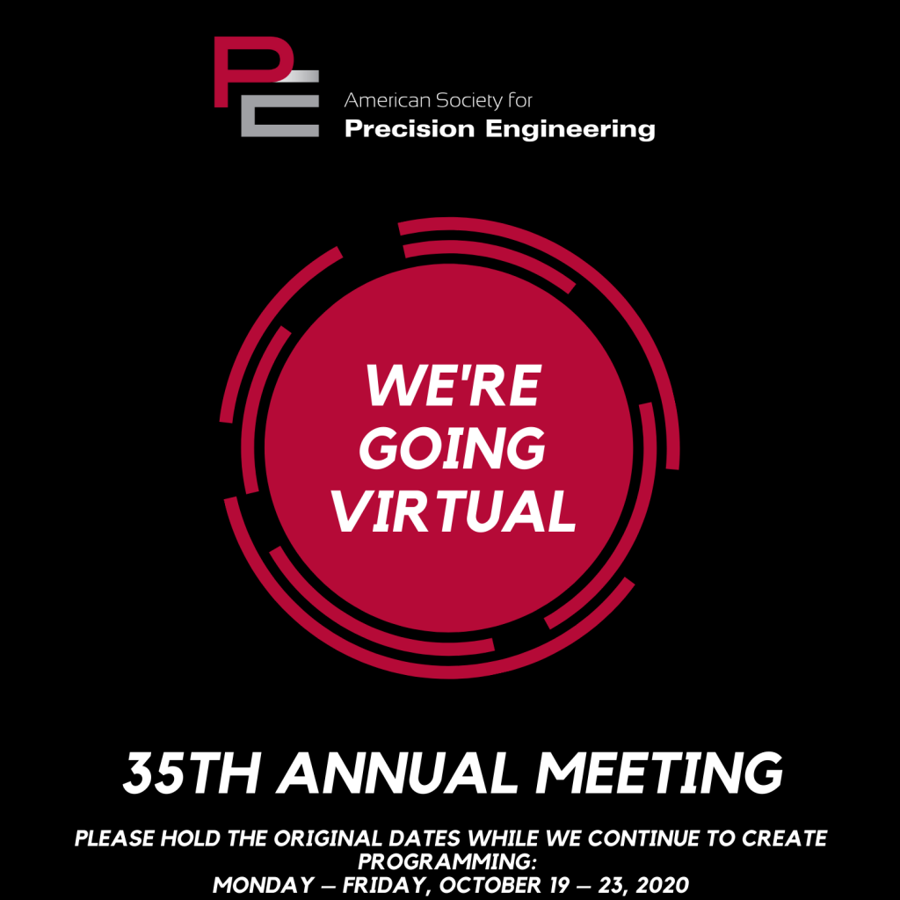





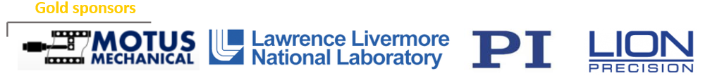



Platinum sponsors
Gold sponsors
Silver sponsors
Last updated: Sep 24, 2020

Slide 2
Team Picture/s, School/s Logos and Mascot…

Slide 3
OUTLINE (example)
Design including well labeled images to illustrate operating principles and assembly
Demonstrating that their designed scribe tool mechanism could be assembled into the XY stage using a solid model assembly
Uncertainty budget (optional); However, if included you may get feedback from judges.
Electro-mechanical control strategy

